Slide 1
Trade&Ahead- Stocks and Investment Management.
Unsupervised Learning- K-means and Hierarchical Clustering
12/01/2023

Slide 2
Contents / Agenda
Executive Summary
Business Problem Overview and Solution Approach
EDA Results
Data Preprocessing
K-Means Clustering
Hierarchical Clustering
Appendix

Slide 3
Executive Summary
Hierarchial clustering method is the preferred method employed to analyze stocks across different market segments in our data compared the K-Means method.
We split our stocks into two clusters using K-means method (Elbow and Silhouette) while the stocks were split into seven clusters when we utilized the Hierarchial clustering method.
In Hierarchial clustering method we employed Eucledian distance and Ward linkage then got the number of cluster from viewing our dendogram.
The GICS sub industry groups with the highest percentages are: Oil and Gas, REITs and Industrial conglomerates.
The Energy sector has the highest P/E ratio making it the most attractive for investors but also the sector that is most volatile among all the other sectors making it the riskiest sector to invest in. So investors are advised to look out for these pointers before investing in the stocks.

Slide 4
Business Problem Overview and Solution Approach
Stock investment has been an attractive venture over the years and having a diversified portfolio may yield higher returns and lower risk by tempering potential losses when the market is down.
Cluster analysis is how we can identify stocks that exhibit similar characteristics or show maximum correlation and stocks that show minimum correlation.
Trade&Ahead has provided me with some data on stock price and some financial indicators for a few companies listed under the New York Stock Exchange. This project details how the data was analysed, how the stocks were grouped as based on the attributes provided and shows insights about the characteristics of each group made.
Carrying out an effective cluster analysis will help investors to analyze stocks across different market segments more effectively and help manage or prevent against risks that could make the portfolio vulnerable to losses.

Slide 5
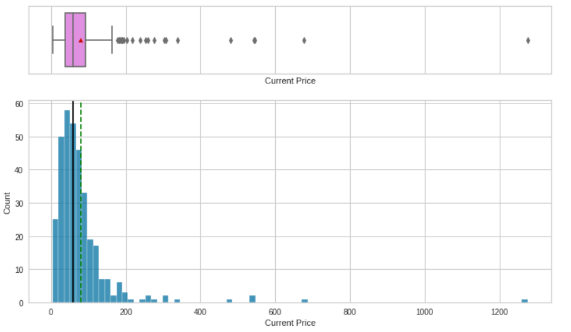
EDA Results
Univariate Analysis- Current Price
Observation
The current price plot is right skewed with heavy presence of outliers.

Slide 6
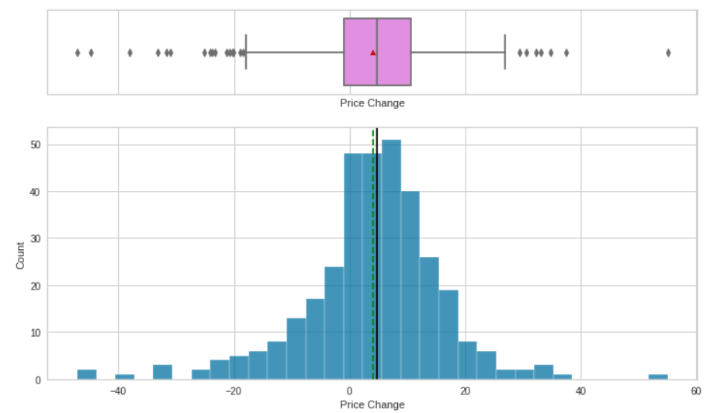
EDA Results
Univariate Analysis- Price Change
Observation
Here we have a fairly normal distribution with presence of outliers on both sides.

Slide 7
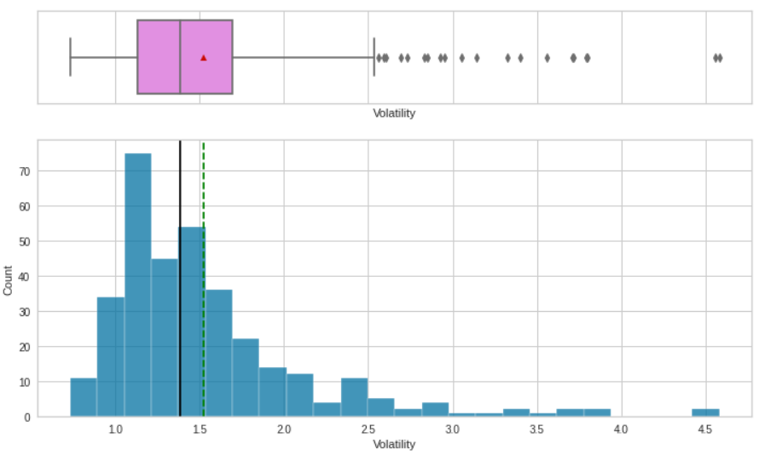
EDA Results
Univariate Analysis- Volatility
Observation
The volatility plot is gently right skewed with some presence of upper outliers.

Slide 8
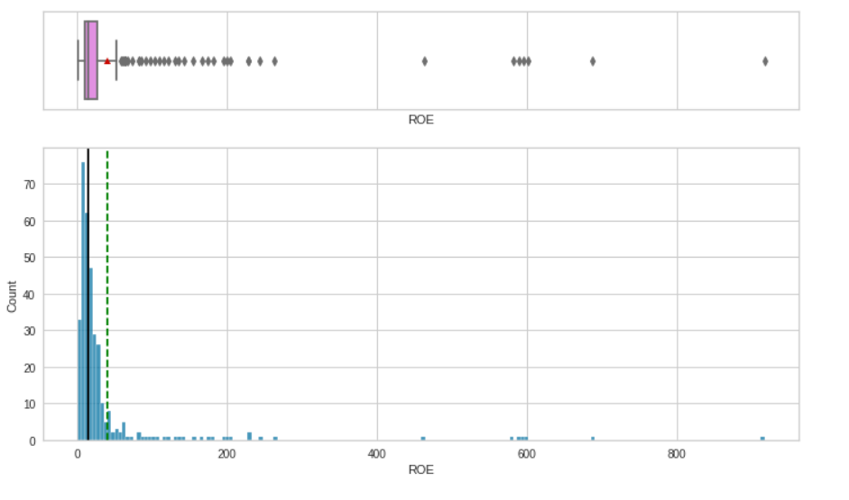
EDA Results
Univariate Analysis- ROE
Observation
The plot is heavily right skewed with presence of dense upper outliers.

Slide 9
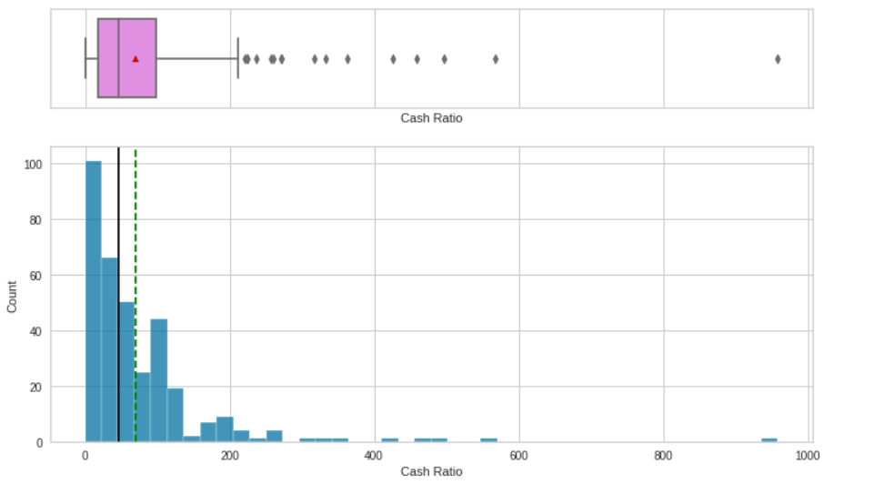
EDA Results
Univariate Analysis- Cash Ratio
Observation
The cash ratio plot is right skewed with some presence of outliers.

Slide 10
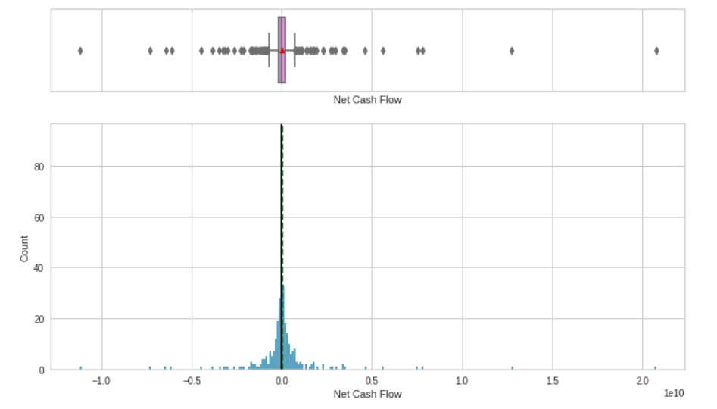
EDA Results
Univariate Analysis- Net Cash Flow
Observation
Our boxplot is a normal distribution with presence of heavy outliers on both sides of our plot.

Slide 11
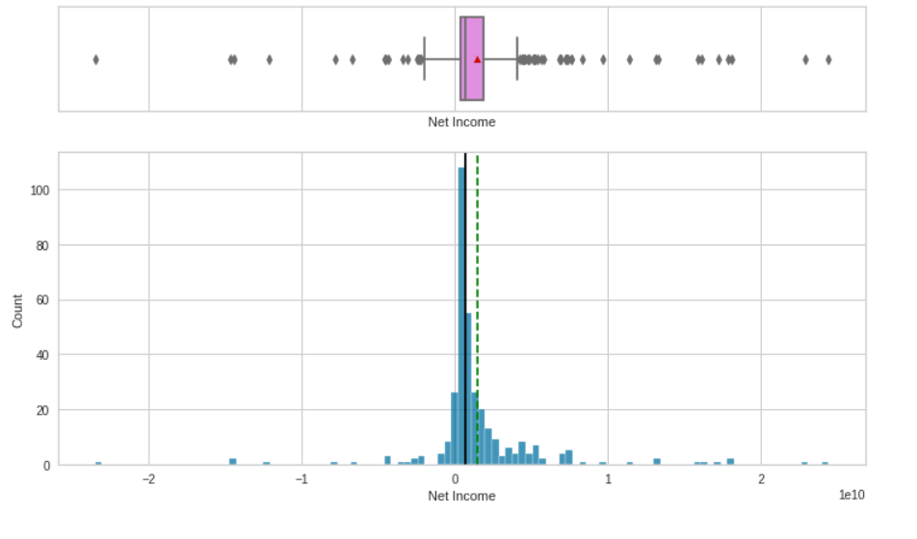
EDA Results
Univariate Analysis- Net Income
Observation
The net income plot is tending towards a normal distribution with heavy presence of outliers on both sides.

Slide 12
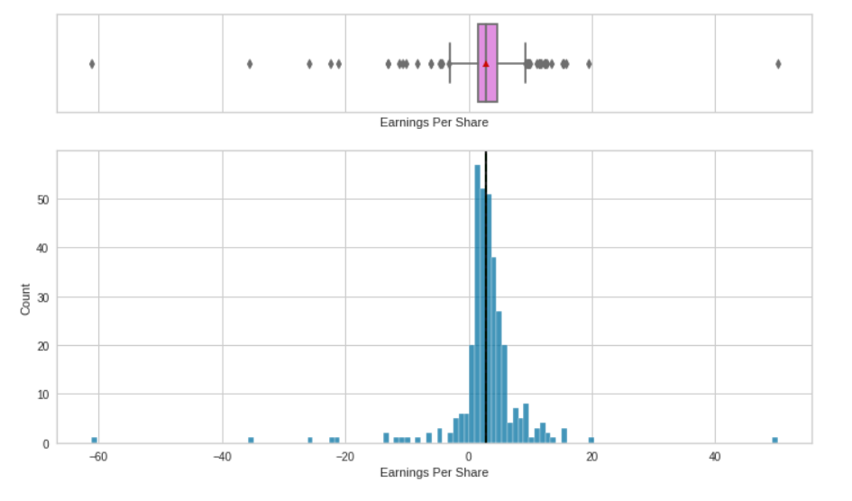
EDA Results
Univariate Analysis- Earnings Per Share
Observation
The plot is a normal distribution with presence of outliers on both sides.

Slide 13
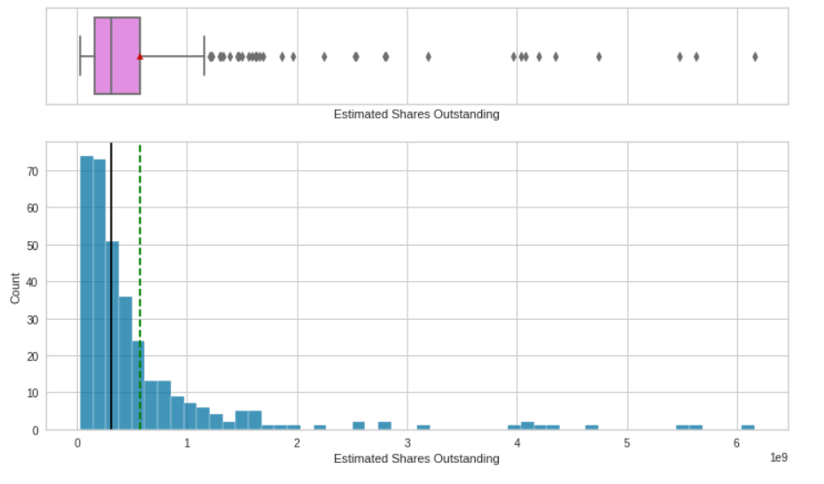
EDA Results
Univariate Analysis- Estimated Shares Outstanding
Observation
The plot is heavily skewed to the right with presence of outliers on the right.

Slide 14
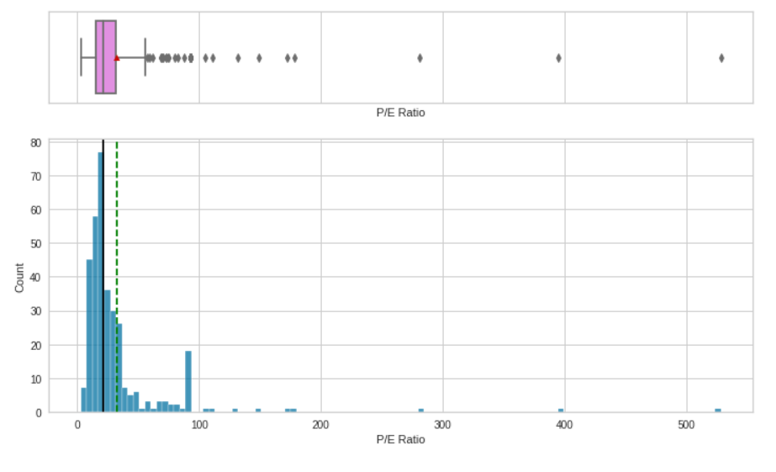
EDA Results
Univariate Analysis- P/E Ratio
Observation
The P/E ratio plot is right skewed with some heavy presence of outliers.

Slide 15
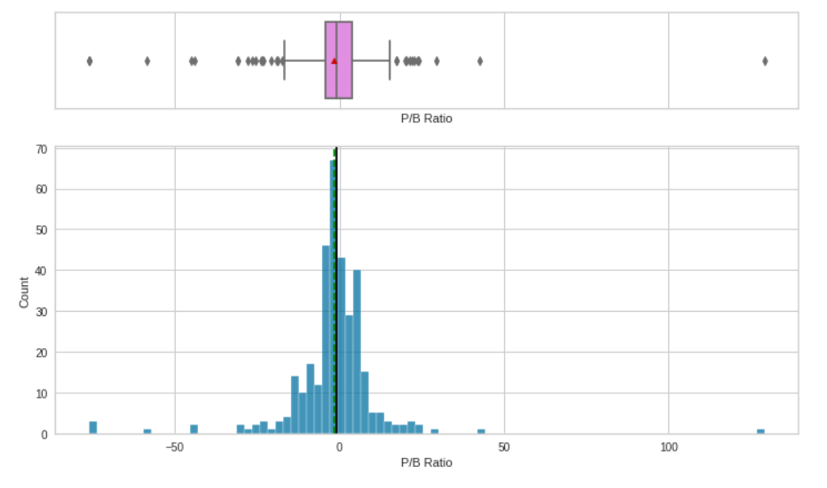
EDA Results
Univariate Analysis- P/B Ratio
Observation
The plot appears to tend towards a normal distribution with heavy presence of outliers on both sides.

Slide 16
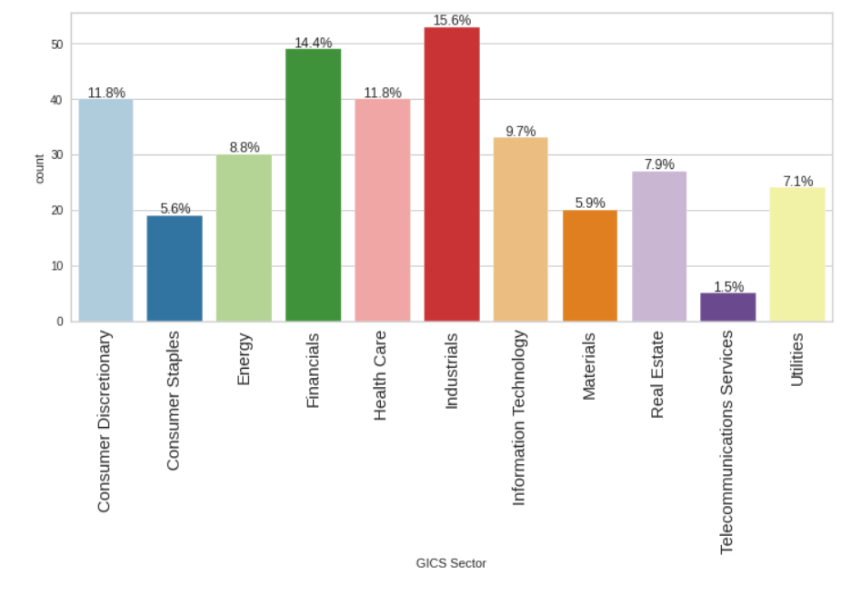
EDA Results
Univariate Analysis- GICS Sector
Observation
Industrials sector makes up 15.6% of the economic sector while the Telecommunications services is the least at 1.5%.

Slide 17
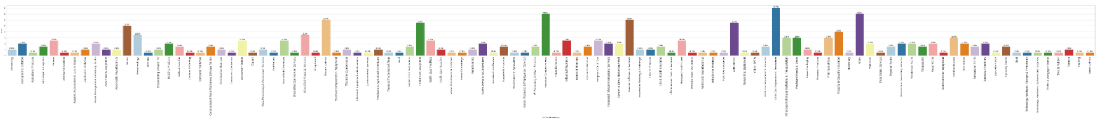
EDA Results
Univariate Analysis- GICS Sub Industry
Observation
The GICS sub industry groups with the highest percentages are:
Oil and Gas Exploration and production 4.7%
REITs 4.1%
Industrial Conglomerates 4.1%
Electric utilities 3.5%
Health and care equipment 3.1%
Some of the GICS sub industries at 0.3% rate:
Gold, Environmental services, Home furnishings, Drug retail, Industrial materials, Industrial gases etc.

Slide 18
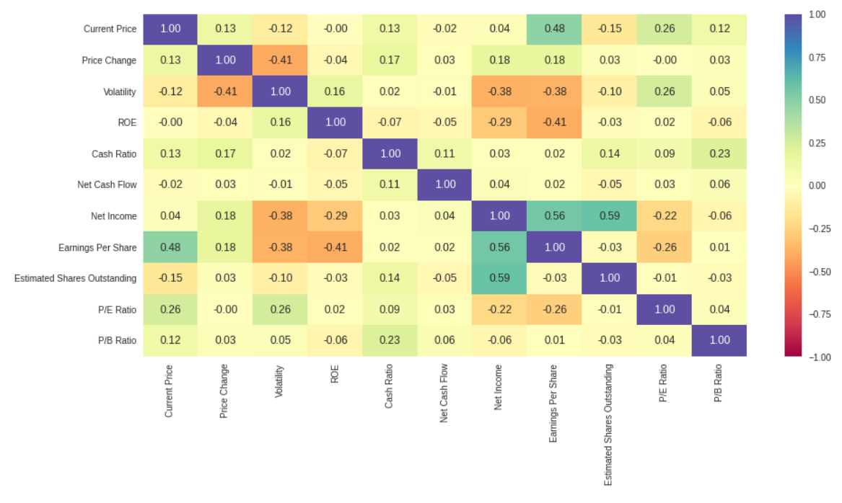
EDA Results
Bivariate Analysis- Correlation check between variables
Observation
Net income and Estimated Shares Outstanding are moderately correlated at 0.59.
Medium positive correlation between Net income and Earnings per Share at 0.56.
Most of the variables have very low correlation between them.

Slide 19
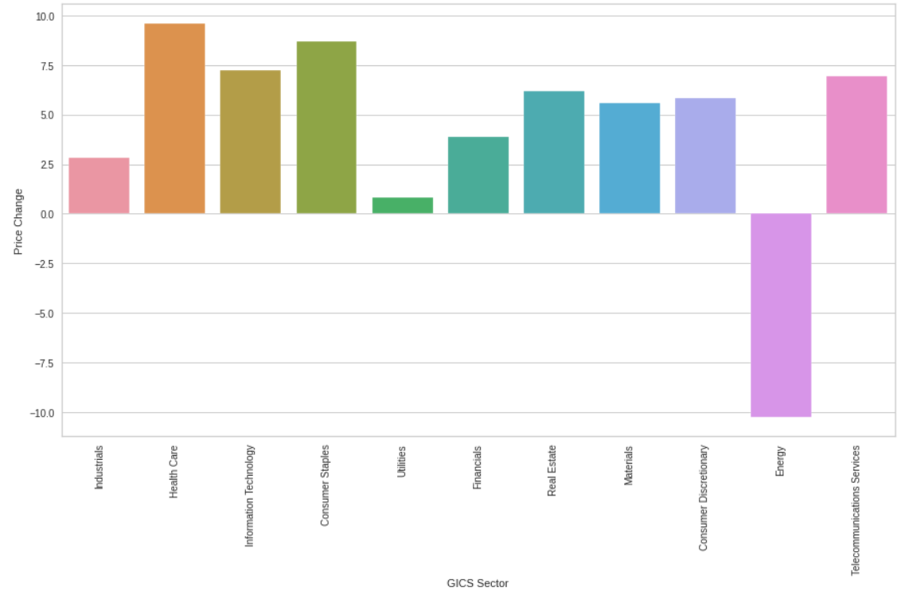
EDA Results
Bivariate Analysis- Price Change vs. GICS Sector
Observation
Energy sector has a negative low price change .
Health care and Consumer Staples have the maximum price increase on average.

Slide 20
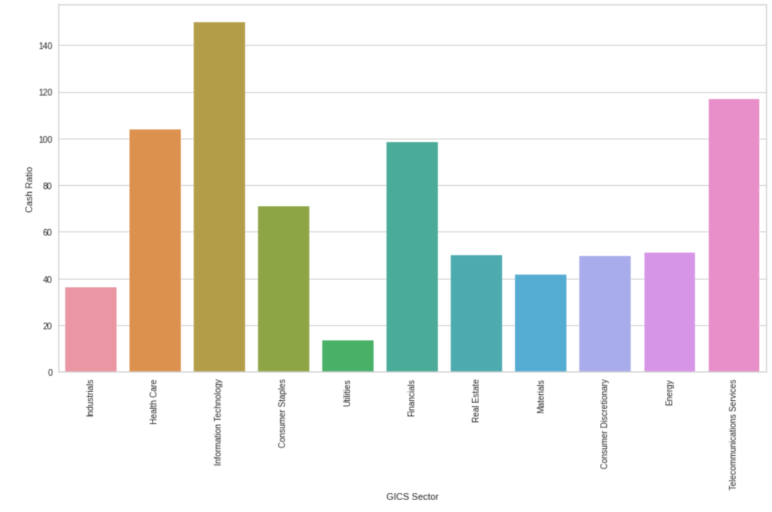
EDA Results
Bivariate Analysis- Cash Ratio vs. GICS Sector
Observation
Information Technology has the highest cash ratio, followed by Telecommunication services.
Utilities has the lowest cash ratio.

Slide 21
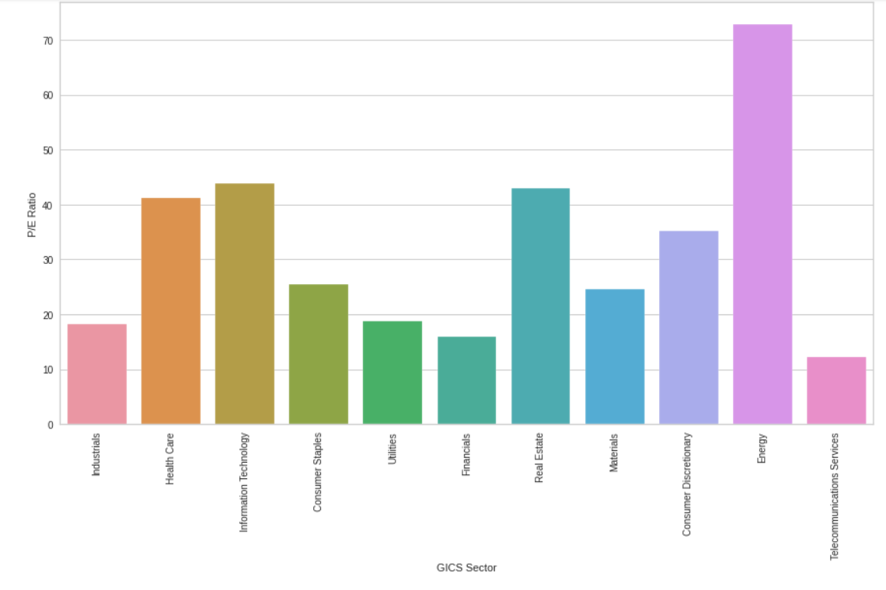
EDA Results
Bivariate Analysis- P/E Ratio vs. GICS Sector
Observation
The Energy sector has the highest P/E ratio making it the most attractive for investors while Telecommunication sector has the least.

Slide 22
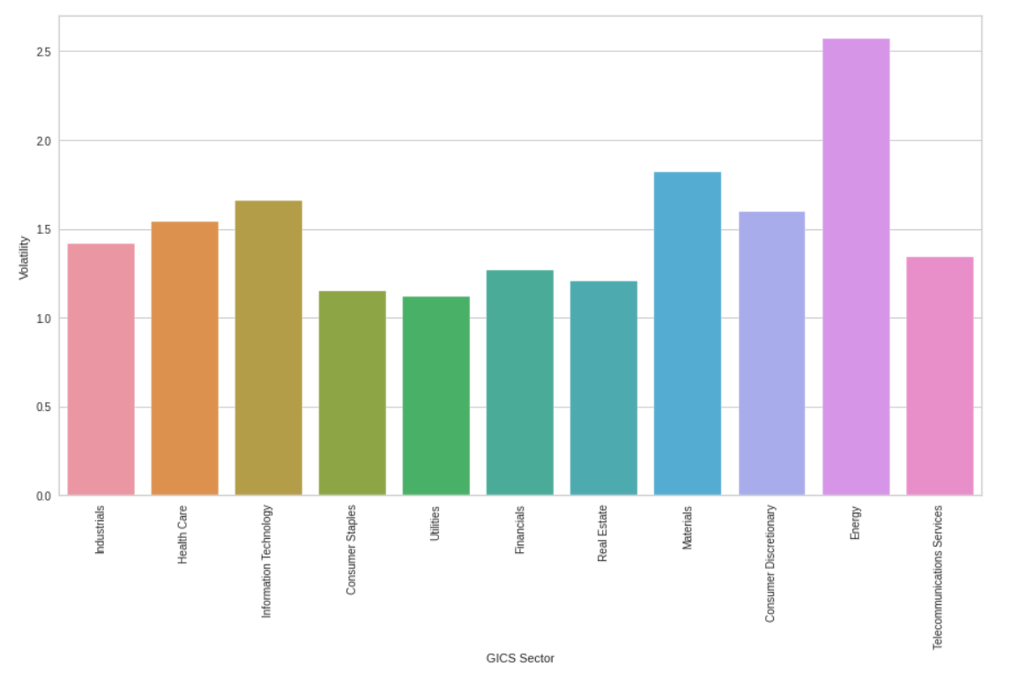
EDA Results
Bivariate Analysis- Viscosity vs. GICS Sector
Observation
The Energy sector is the most volatile among all the other sectors making it the riskiest sector to invest in.

Slide 23
Data Preprocessing
Duplicate value check- No duplicates were found
Missing value treatment- No missing values, but by viewing the dataset, it seems that missing values in the data had already been treated.
Outlier check- The dataset has many outliers but it was not treated because they could be genuine values.
Data preparation for modeling - I scaled the numeric columns on the data set and also created a new dataframe from the scaled data. This was done before clustering .

Slide 24
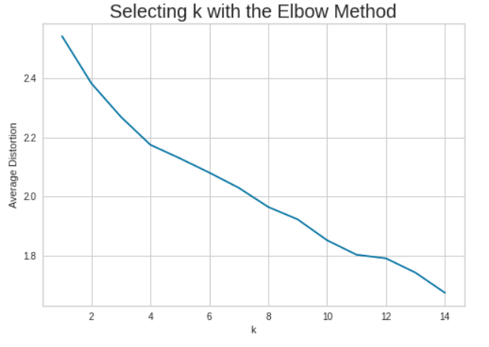
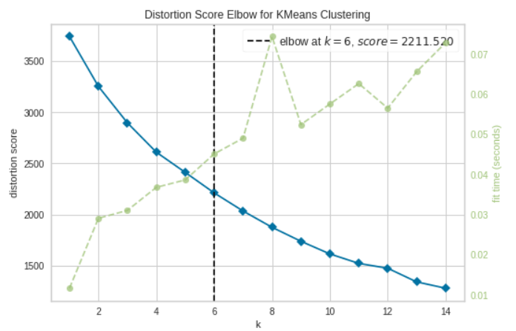
K-Means Clustering Summary
Observation
Using the elbow method, the appropriate value of K is 6 making our optimal number of clusters 6.

Slide 25
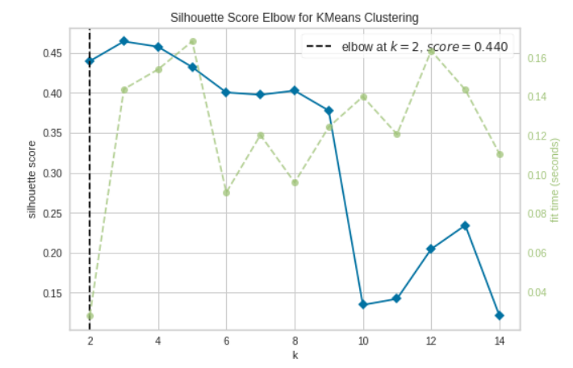
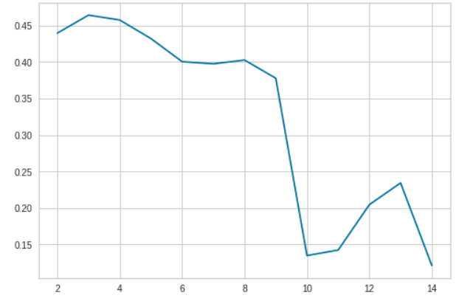
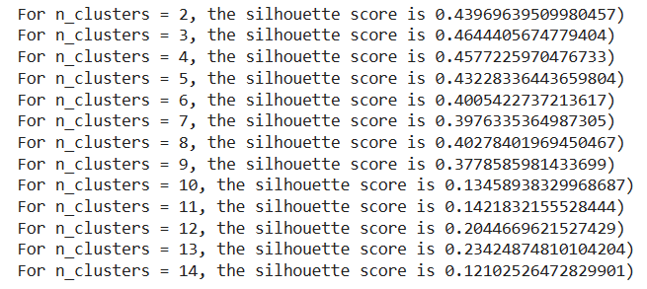
Hierarchical Clustering Summary
Observation
The silhouette scores closest to +1 are clusters 2, 3, 4, 5,6 and 8 and hence makes them the optimal clusters of choice.
However fitting the data to the visualizer ties the elbow at K=2

Slide 26
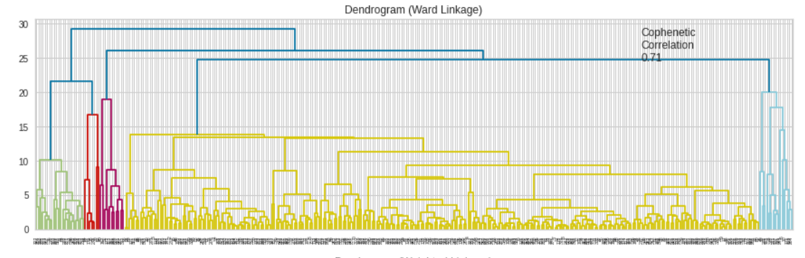
Hierarchical Clustering Summary
Observation
Even though Cophenatic Correlation was 0.71, the preferred optimal number of clusters using hierarchical clustering was 7. Eucledian distance and Ward linkage were employed.

Slide 27
APPENDIX

Slide 28
Data Background and Contents
The data contains information on stock price and some financial indicators in some companies as seen in 340 rows and 15 columns data provided.
The datatypes are float64(7), int64(4), object(4).
No duplicated variable seen
From viewing the data, it is seen that the missing values in the data must have been treated. They were a number of NAN values present.

Slide 29
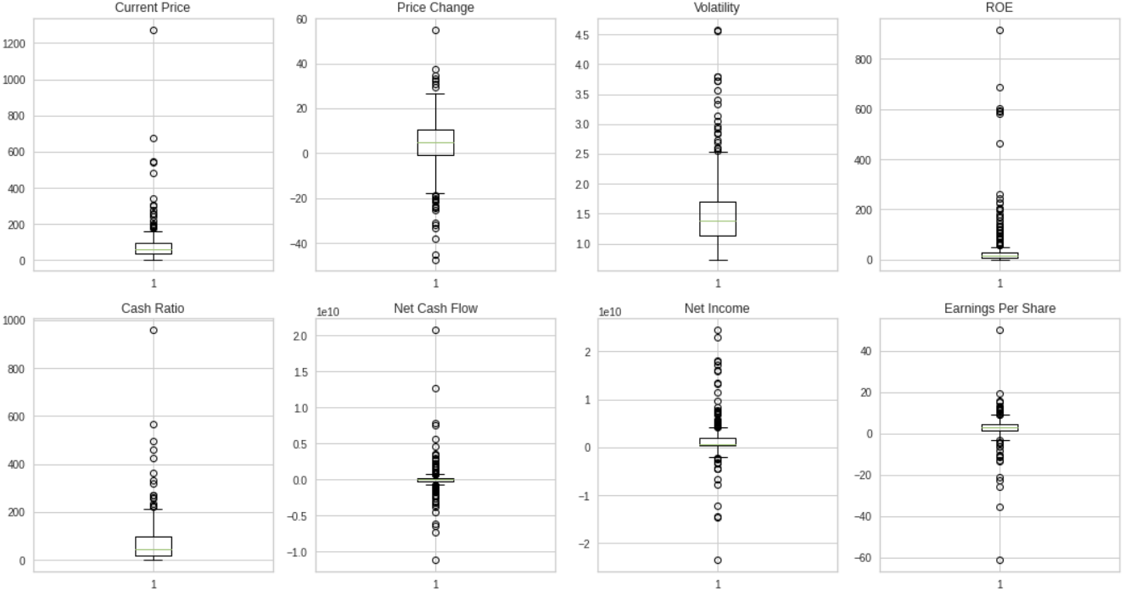
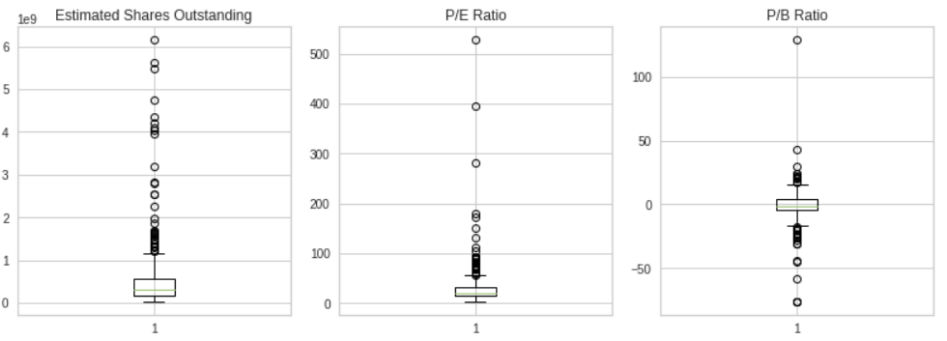
Data Background and Contents
Observation
All the numerical variables in the dataset have outliers

Slide 30
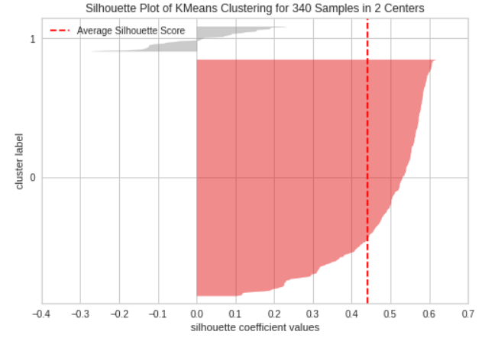
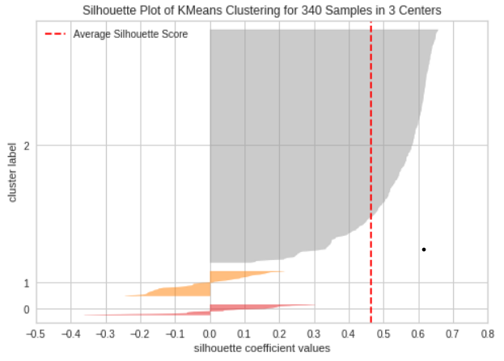
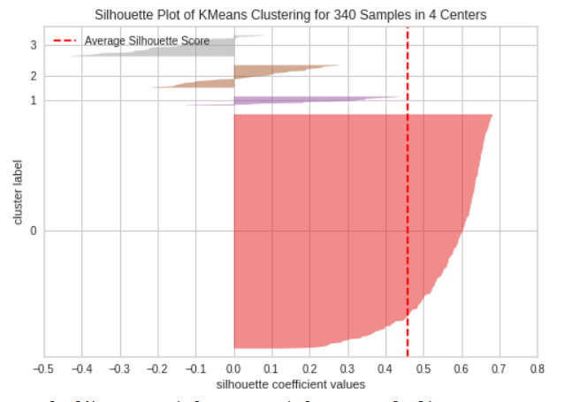
K-Means Clustering Technique
Determining the K-means by viewing the elbow method was not quite very effective, it took some contemplation before settling down on the right factor using the visualizer.
Observations from Silhouette scores for different number of clusters also came with a number of challenges regarding the n_cluster (no of cluster) to settle on.
The best silhouette score should be close to +1 to enable us determine the optimal cluster. Clusters 2, 3, 4, 5,6 and 8 are the best choices but visualizing the scores came with some challenges.
Silhouette plots 2, 3 and 4 show that some clusters are lower than the average silhouette scores though most of the clusters in plot 2 were above the average score line. Some of the clusters are also tending towards the negative meaning that some points belong to the neighbouring cluster.

Slide 31
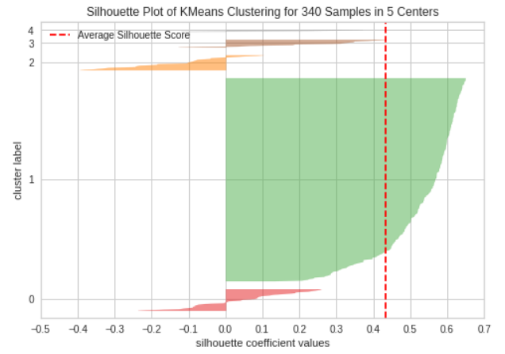
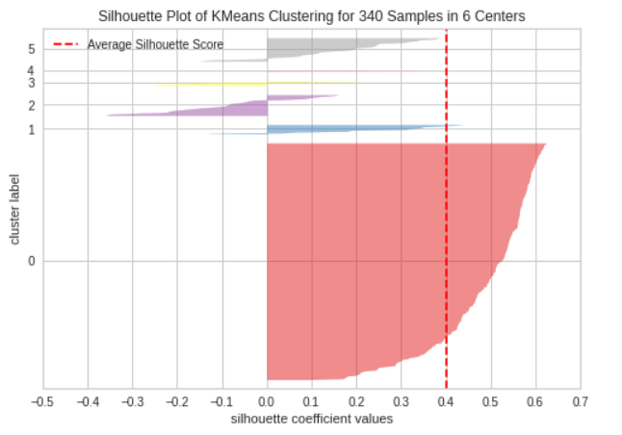
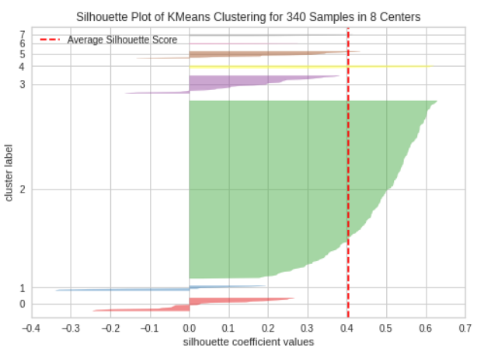
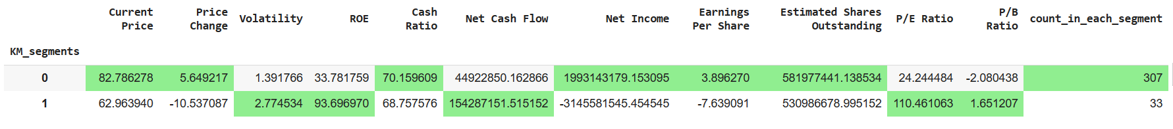
K-Means Clustering Technique
Silhouette plots 5, 6 and 8 show that some clusters are lower than the average silhouette score line. Some of the clusters are also tending towards the negative.
A number of clusters from Silhouette plot 8 crossed the average score line but optimal cluster of choice is cluster 2 and this was used to build our final model. See below:

Slide 32
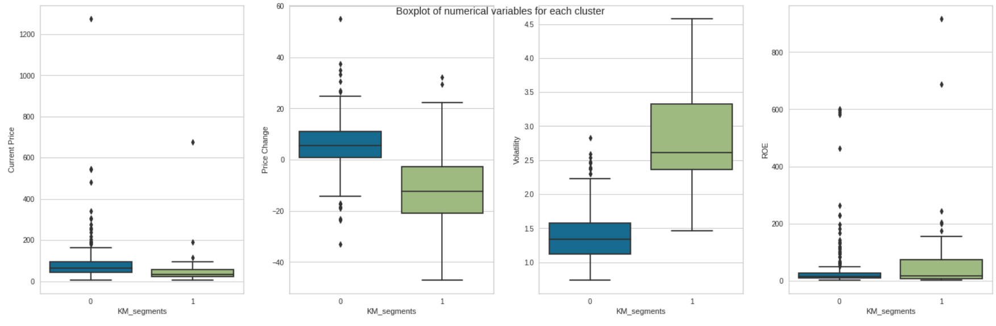
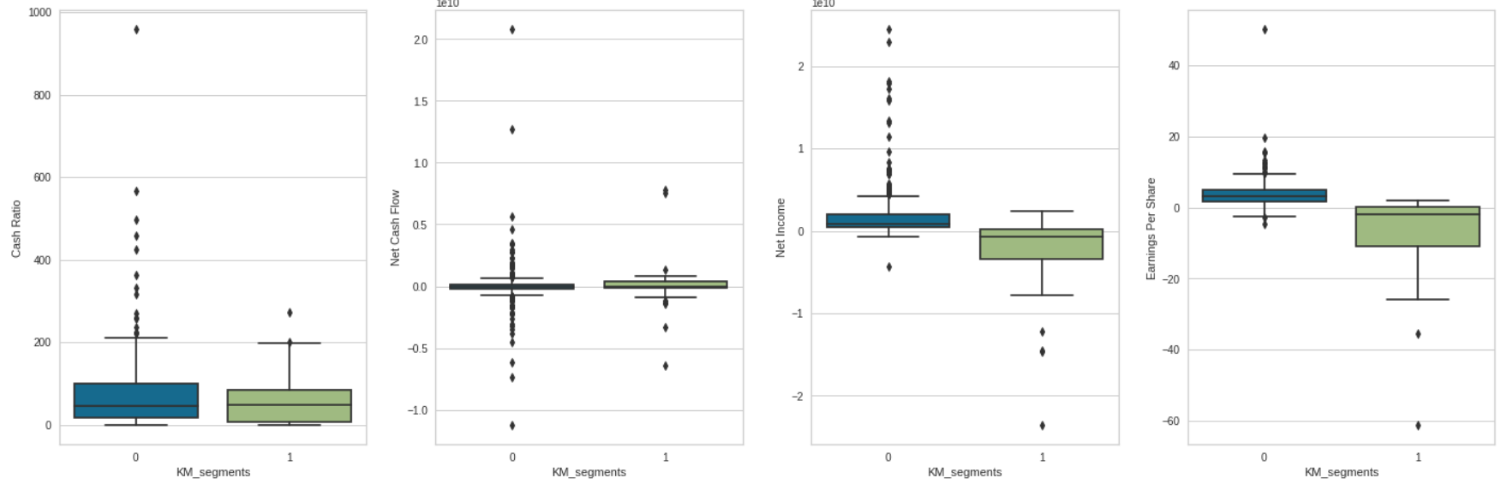
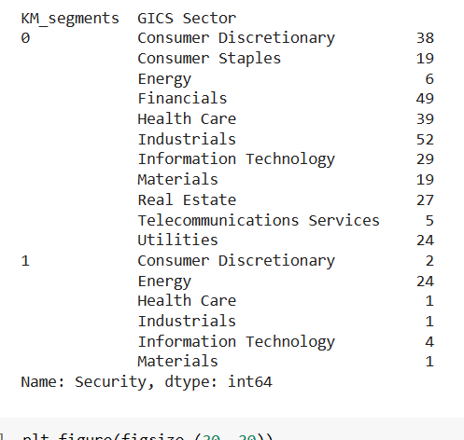
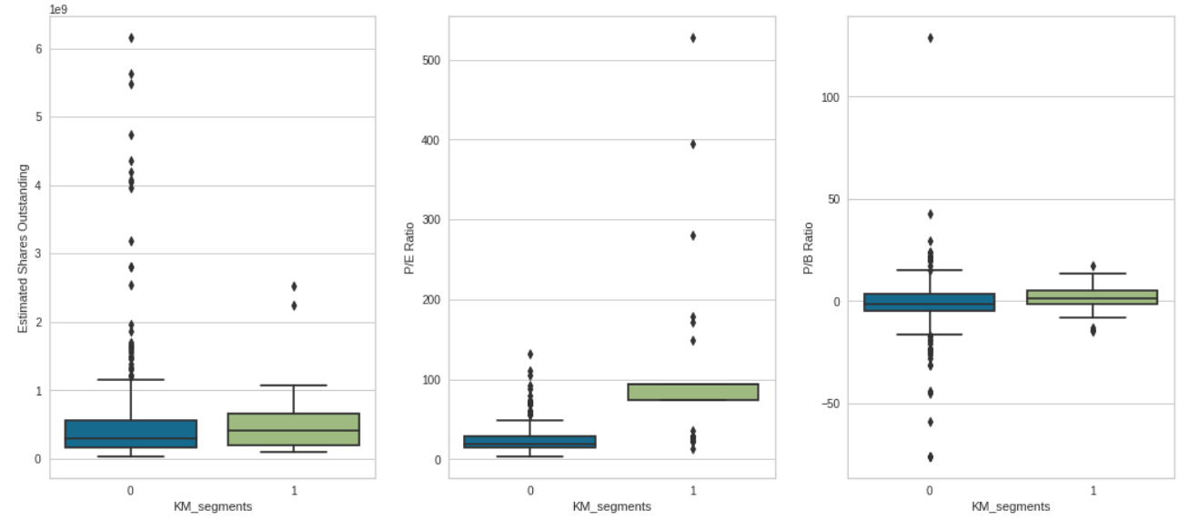
K-Means Clustering Technique

Slide 33
Hierarchical Clustering Technique
For Hierarchical Clustering, we made use of the following distances; Euclidean, Chebyshev, Mahalanobis and Cityblock and the following linkages: single, complete, average, weighted.
Highest Cophenetic correlation closest to 1 is 0.9422540609560814, which was obtained with Euclidean distance and Average linkage.
Dendograms were viewed using Eucledian distance for different linkage methods
I chose Ward linkage as the plot has more distinct and separated clusters, they were not overlapping one another and was easy to count , although its cophenetic coefficient was not as high the other linkages.
7 appears to be the appropriate number of clusters from the dendrogram for Ward linkage.
So n_cluster 7, Eucledian distance and Ward linkage were applied to build the final model.
Note: You can use more than one slide if needed

Slide 34
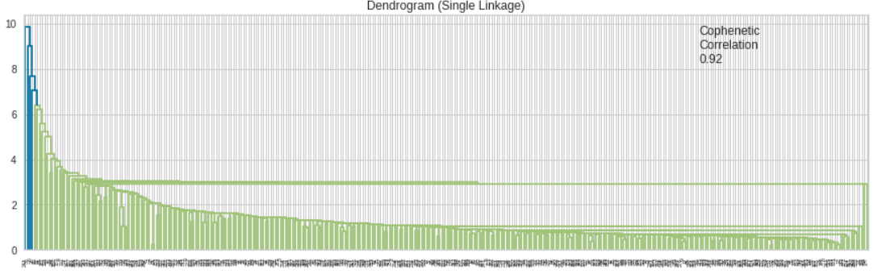
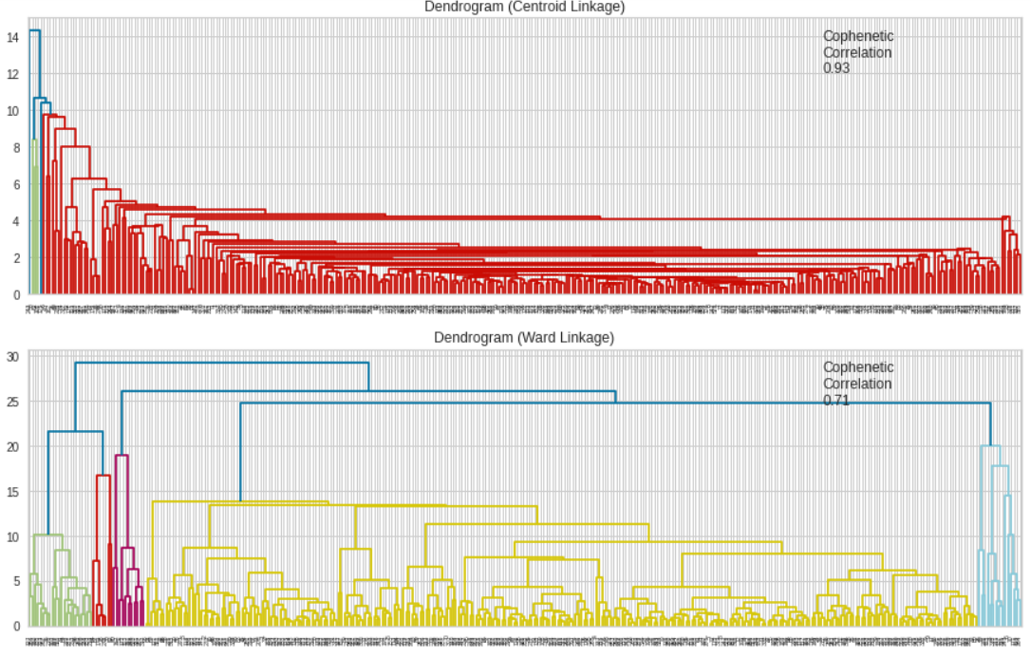
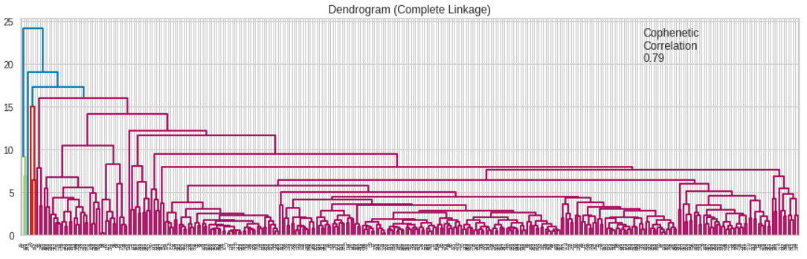
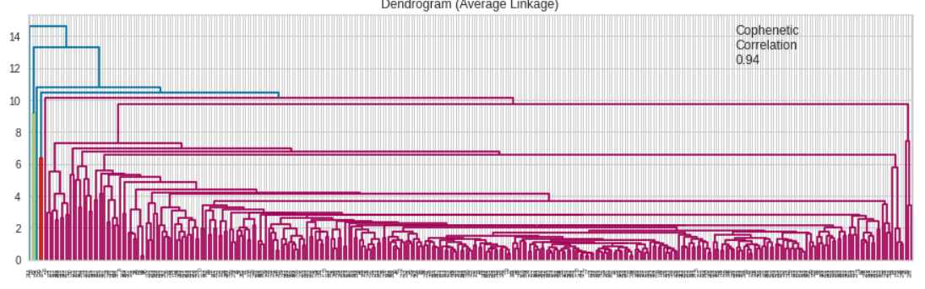
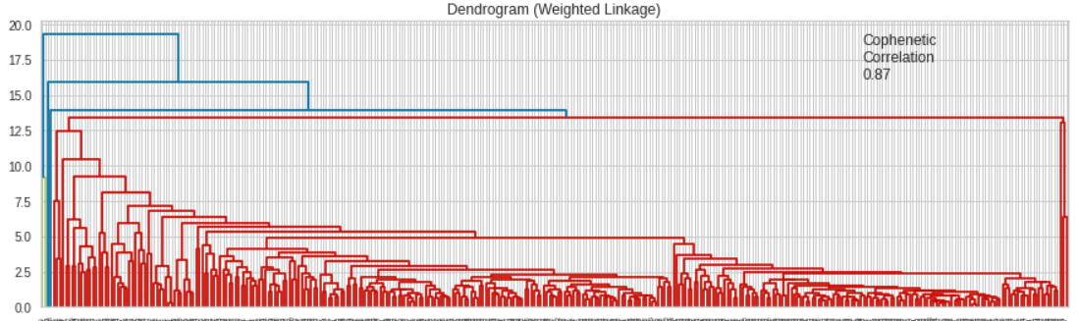
Hierarchical Clustering Technique - Dendograms

Slide 35
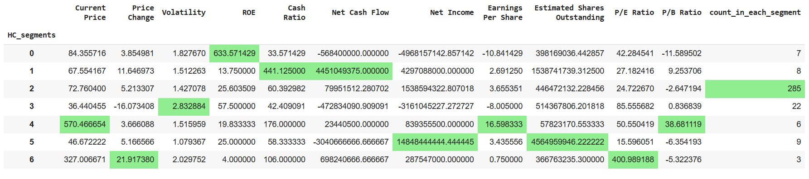
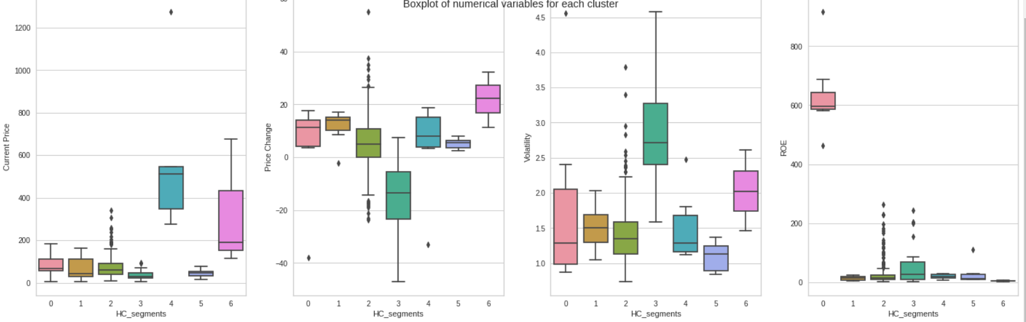
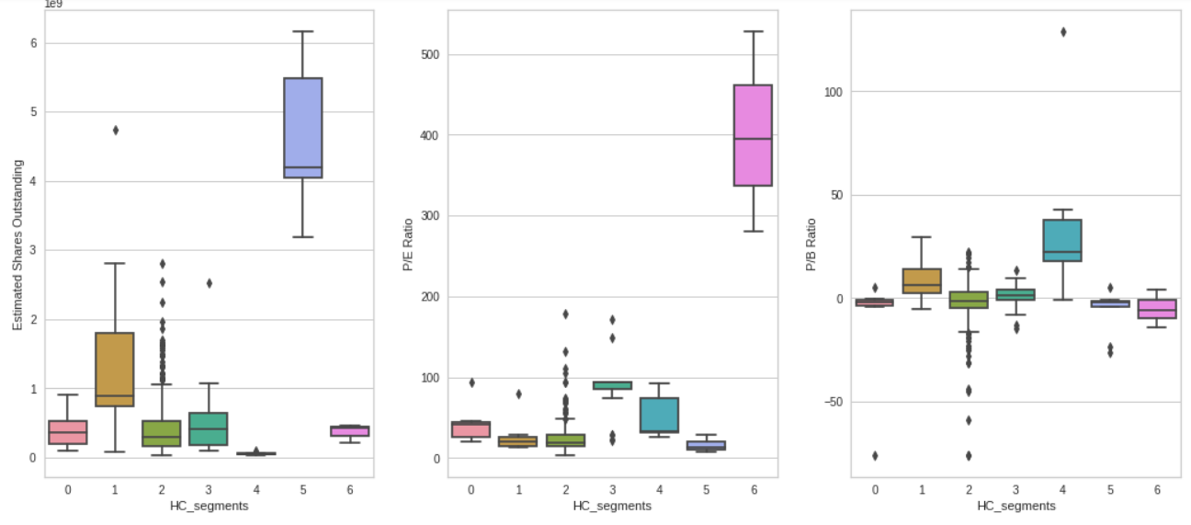
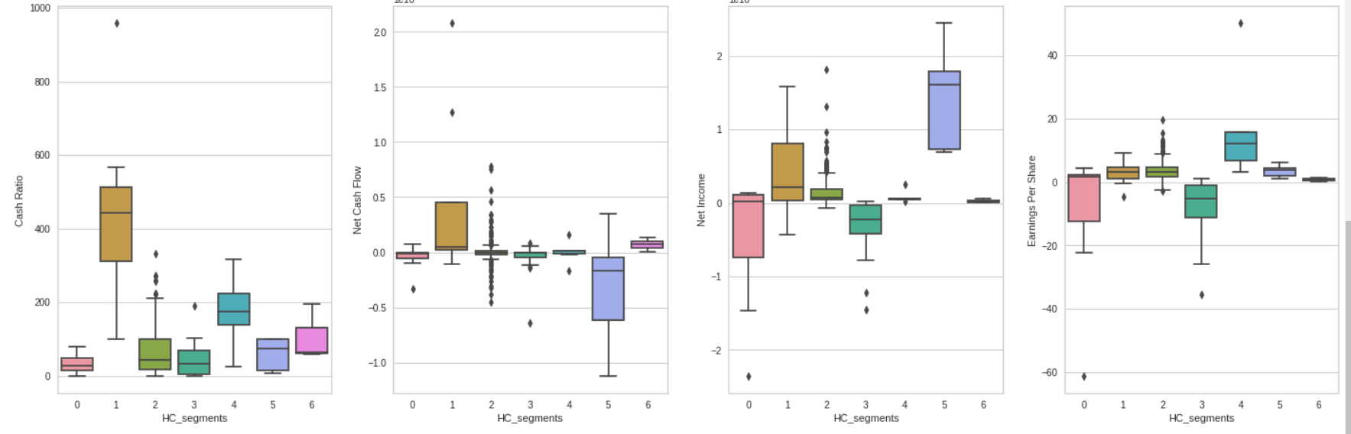
Hierarchical Clustering Technique – Variables in each cluster

Slide 36
K-Means vs Hierarchical Clustering
In K-means method the following observations were made:
Hierarchial clustering method was more straightforward and I made my decision on number of cluster much faster than in K-means method.
The optimal cluster number in the different K means methods were different; Elbow method is 6 while in Silhouette score method 2. Both values are not similar in any way. However in Hierarchical clustering, once the cophenetic correlation was carried out and dendograms were viewed, the cluster number is easily determined.
Hierarchical clustering technique gave more distinct clusters, the number of cluster was 7.
The optimal cluster in K-means method was 2 while in silhouette score was 6, it was difficult to choose the cluster number for the final model.
Eventually, 2 was chosen for the final model. Personally, lumping our data into just two clusters is underutilizing our data while using 6 created a lot of overlapping of clusters into another.
Therefore, the more preferred method is Hierarchial clustering method .

